Slide 1
Welcome to the world of Cambrian Multimedia presentation.

Slide 2
Introduction
Md Hasan Hafizur Rahman
Senior Lecturer
Department of English
Cambrian School & College,Dhaka,
Class-Nine
English
1st Paper

Slide 3
Do you have any idea about a dialogue?
Let us see

Slide 4
Our Today’s Lesson is-
A dialogue on
“Load Shedding”

Slide 5
Learning outcomes
After we have studied this lesson we will be able to-
tell the cause of load shedding
the effect of load shedding
ask and answer questions
write a dialogue.

Slide 6

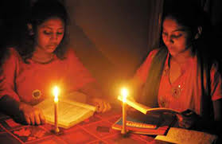

Slide 7
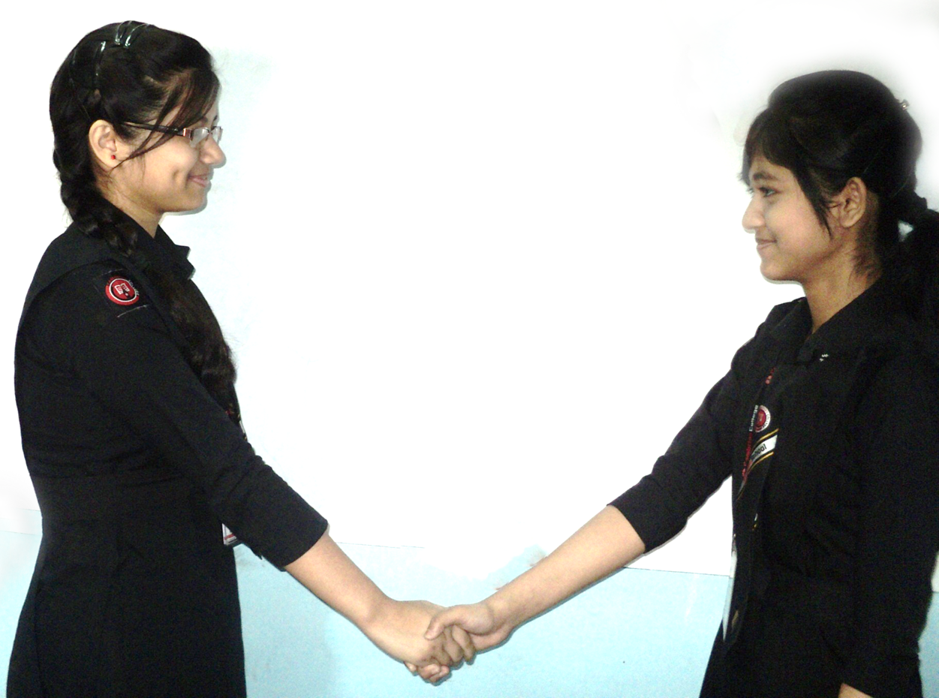
Hi friend, How are you?
I am fine and you?

Slide 8
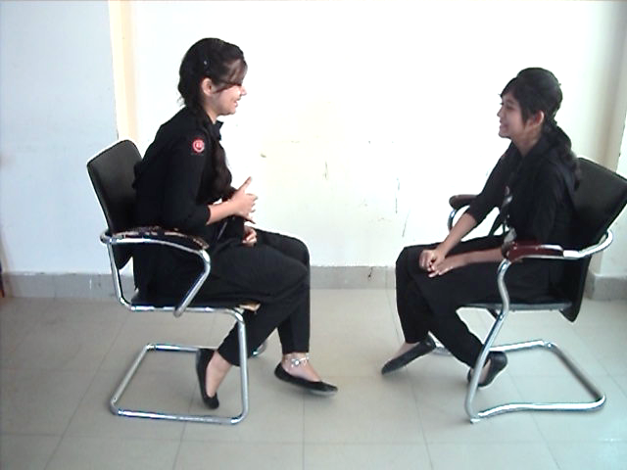
I am so so.
But why?

Slide 9
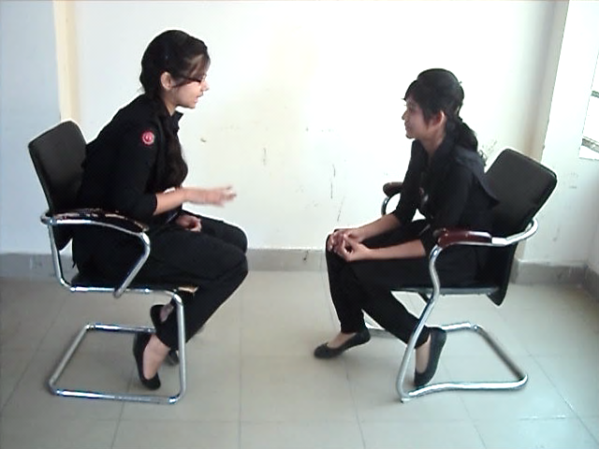
Don’t you follow the condition of our electricity?
Yes, but what is the problem?

Slide 10
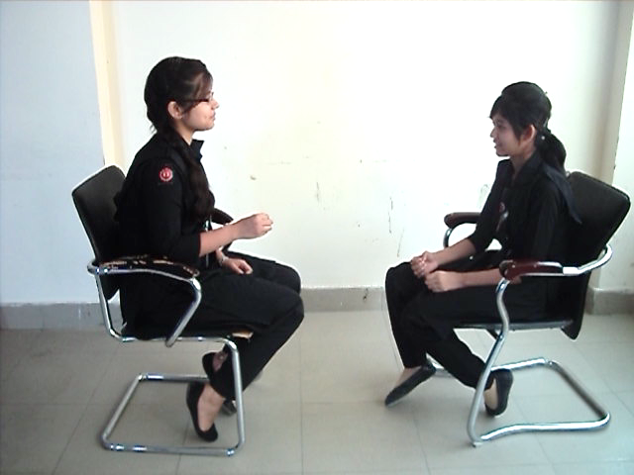
Load shedding.
What is load shedding?

Slide 11
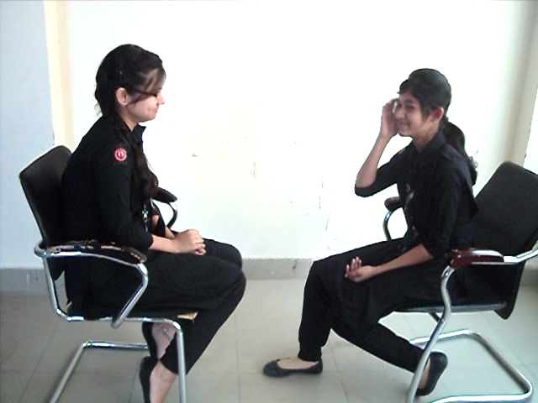
Load is discontinuation of supply of electricity.
Do you mean it the break of electricity?

Slide 12
Yes, you are right.
But what is the cause of load shedding?

Slide 13
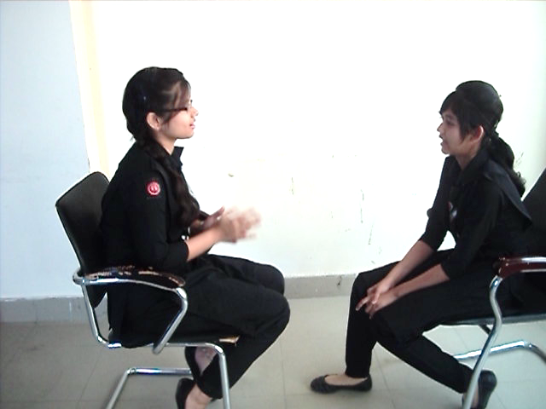
Yes, there are many causes of load shedding.
Please tell me some.

Slide 14
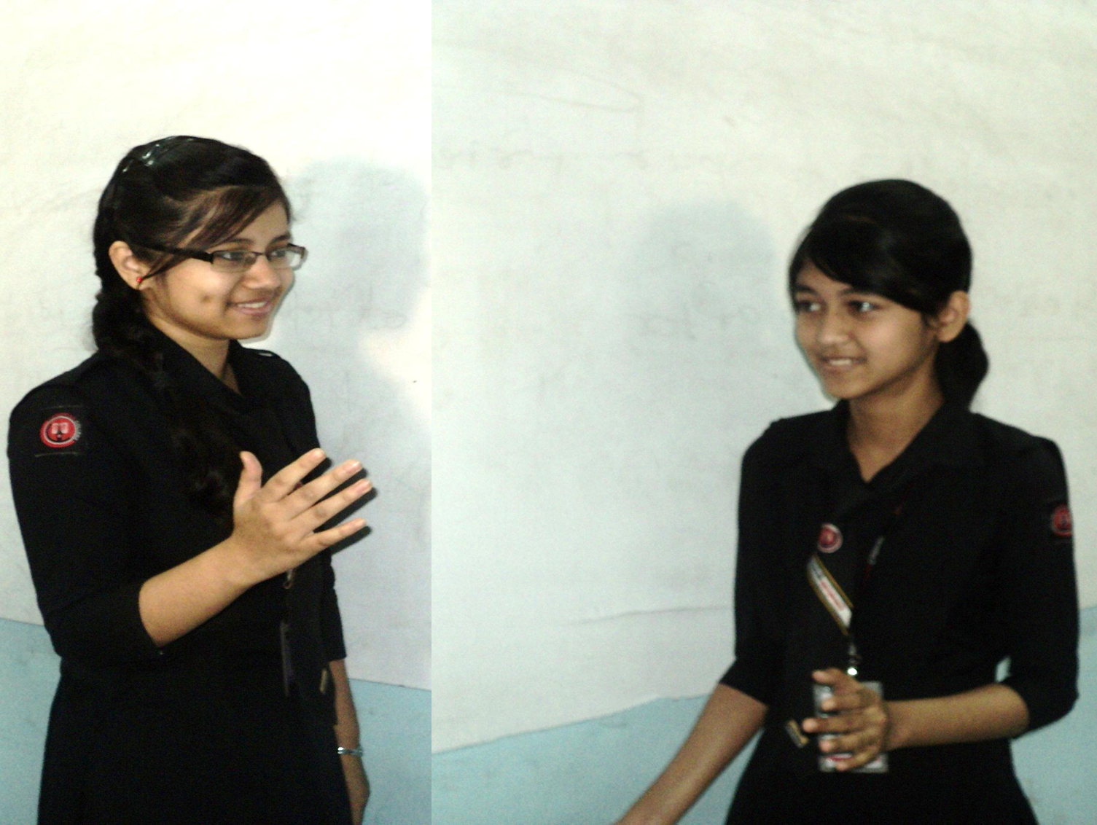
Mismanagement, corruption, illegal connection, system loss and wastage of electricity are main causes of load shedding.
Would you tell me the bad effect of load shedding?

Slide 15
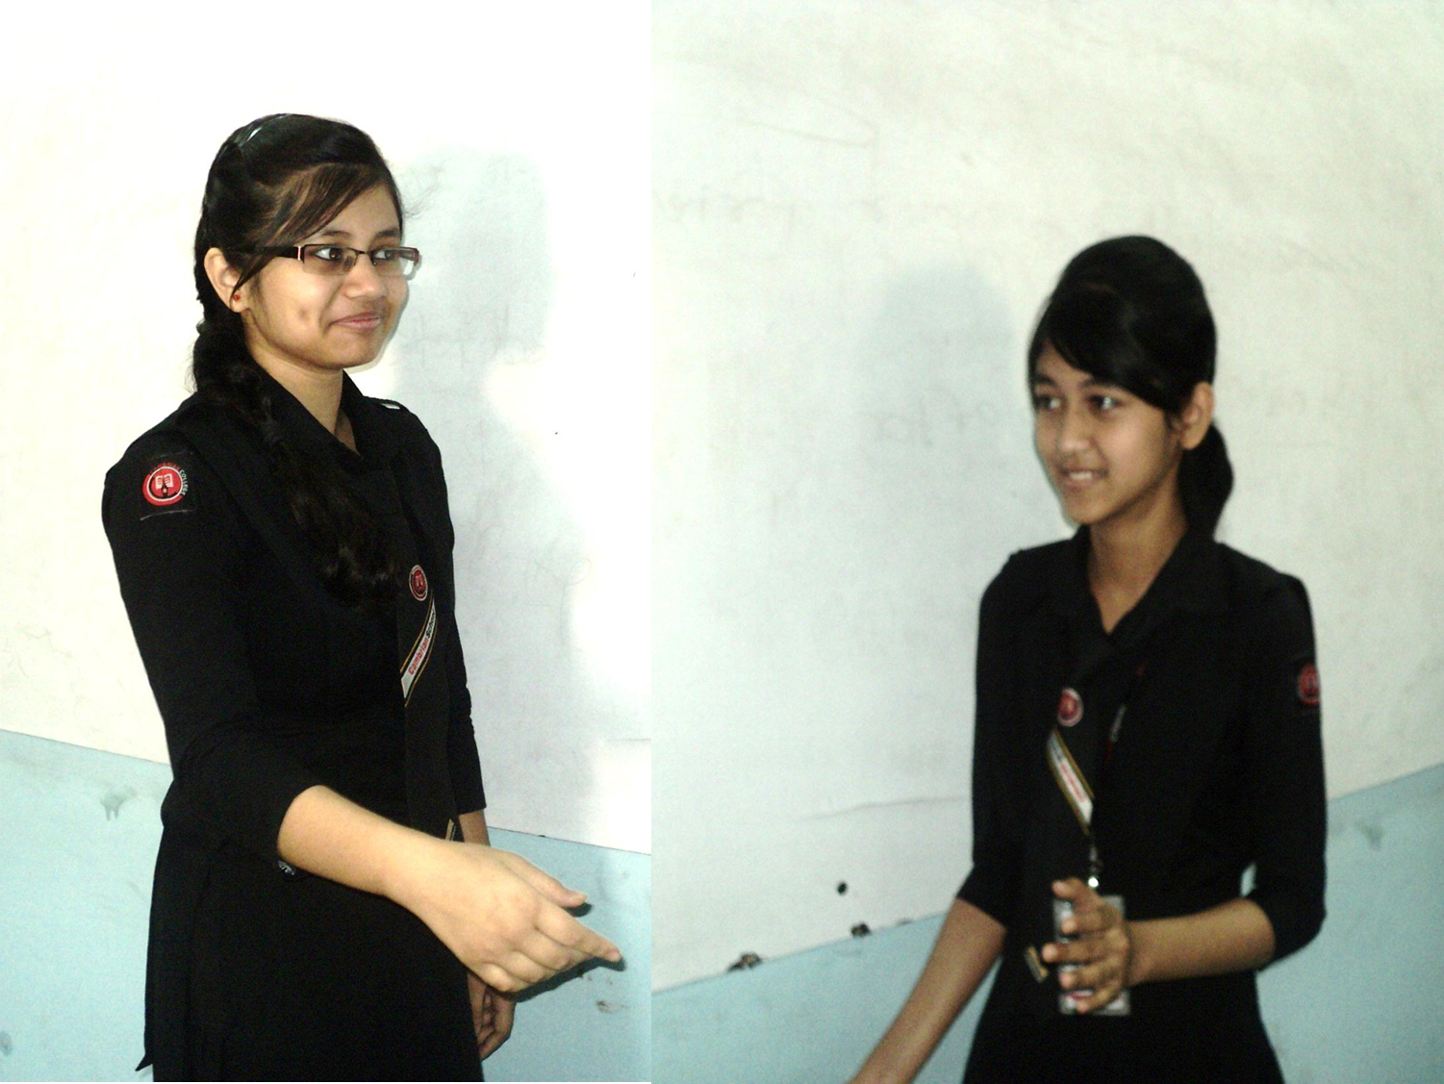
Production of mills and factories are stopped, things kept in the refrigerator and cold storage get rotten.
Now what should we do?

Slide 16
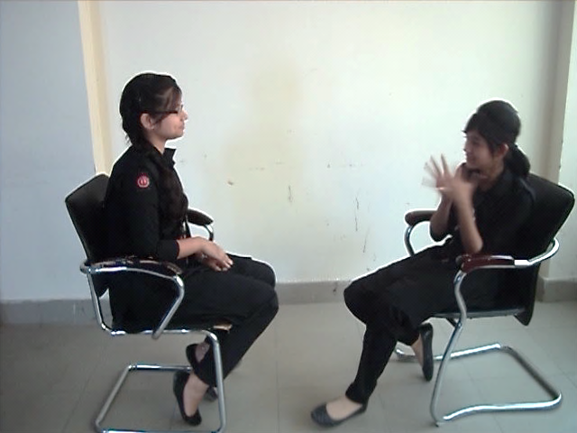
We should increase the production of electricity.
Is it enough?

Slide 17
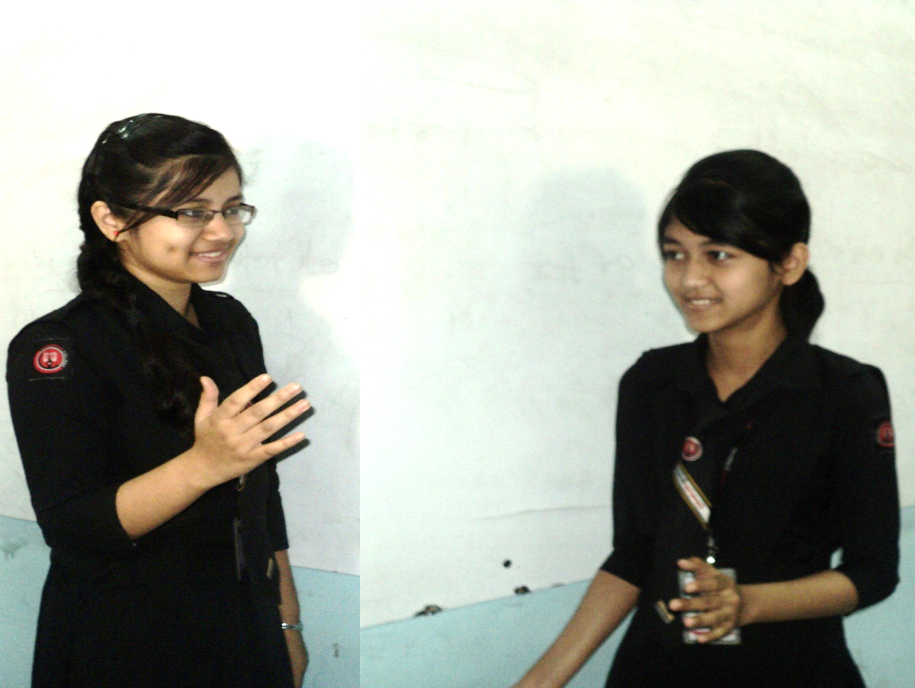
We also should stop mismanagement, corruption, system loss, illegal connection of electricity.
I think you are correct.

Slide 18
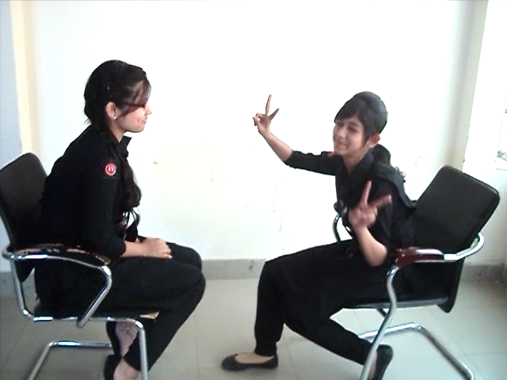
Thank you.
Welcome.

Slide 19
Pair Work
Every single pair is told
to write a dialogue on,
“ Load shedding.”

Slide 20
Evaluation
Answer the following questions-
What is load shedding?
Why is it caused?
What is the bad effect of load shedding?
What should we do to stop load shedding?

Slide 21
Homework
Make a dialogue with your friend about
“Load shedding”

Slide 22
Advice
“Try to save electricity”

Slide 23
Bye bye
Good bye

